Slide 1
Concept 3 - v2
Cinematic Automotive + Virtual Innovation
A premium, technology-forward direction combining dramatic automotive photography with luminous digital overlays, technical graphics, and data-driven details. Deep purples, blues, and neon accents create a cinematic, futuristic aesthetic that feels both sophisticated and grounded in the real world.

Slide 2
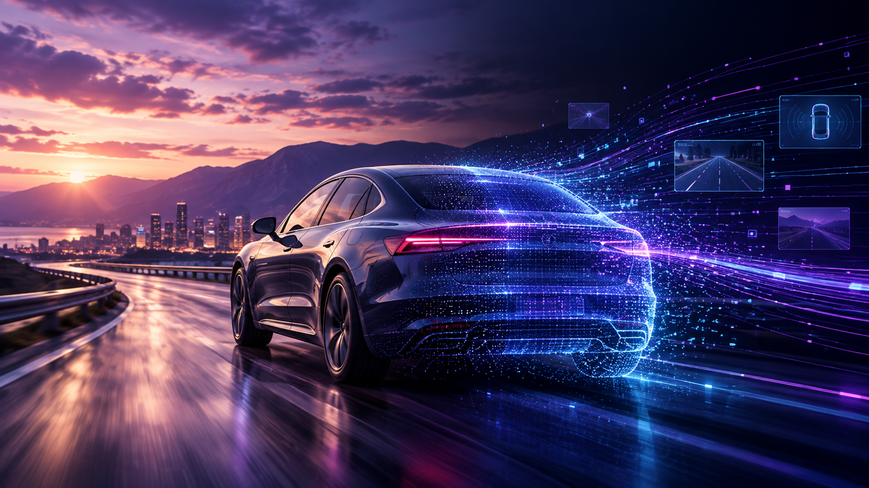

Slide 3
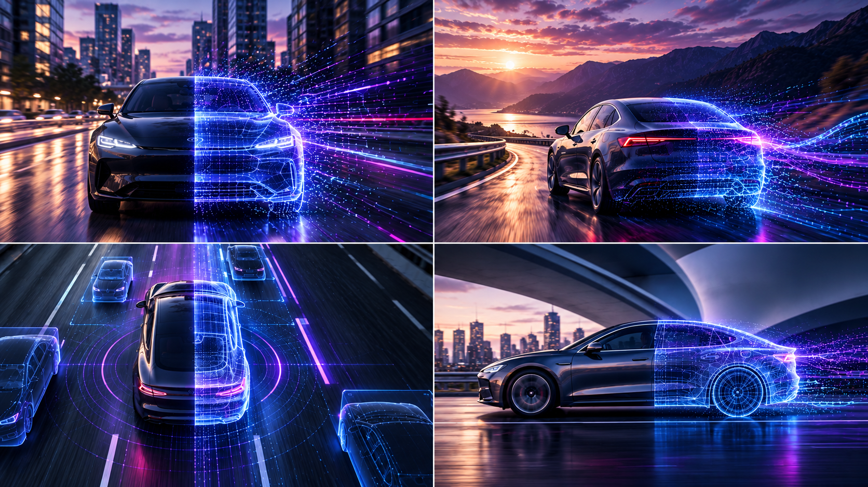

Slide 4
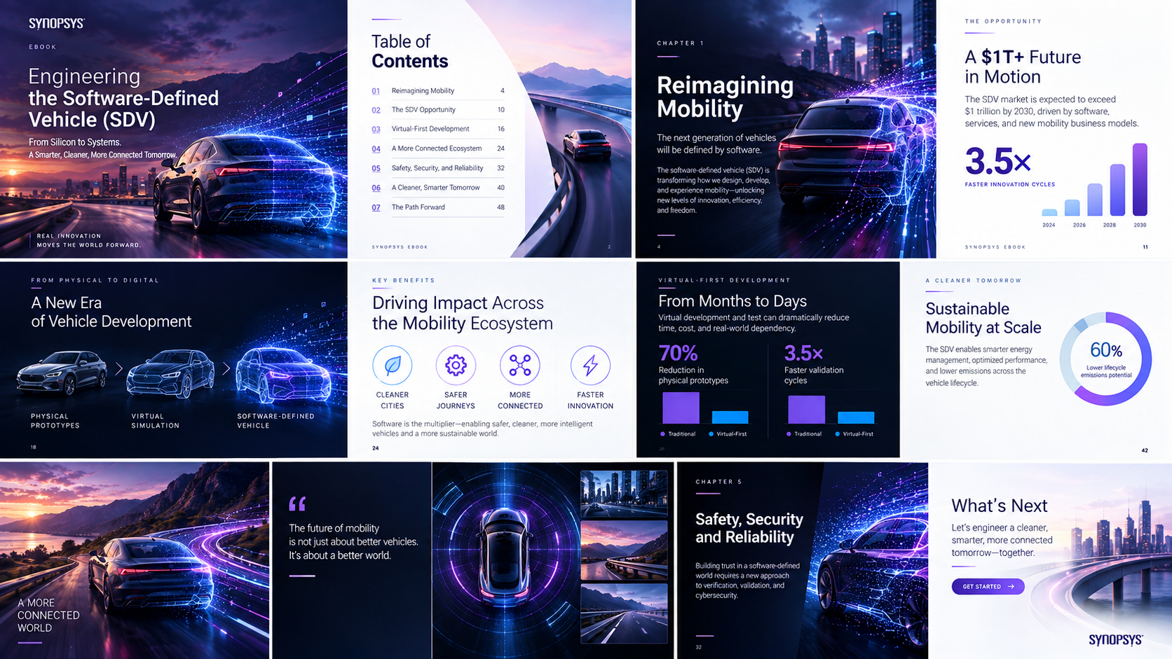

Slide 5


